Slide 1
DBMS • PROJECT
SOFTWARE
MANAGEMENT
SYSTEM
TEAM MEMBERS
25B11AI651 M.SRUJANA
25B11AIA86 S.BHAVYA TULASI
25B11AI910 T.TEJA SRI
Database design for organized software tracking, licensing, installation and maintenance.
25B11AIB85 SANJANA
Batch 10 • Academic Year 2026–2027

Slide 2
02
Outline
A quick view of the project journey
01
Introduction
02
Problem Statement
03
Objectives
04
System Scope
05
Entities & Attributes
06
Relationships & Cardinality
07
Relational Schema
08
ER Diagram
09
Team Responsibilities
10
Conclusion
SOFTWARE MANAGEMENT SYSTEM • DBMS
2

Slide 3
03
Introduction
Why a software management database is useful
THE CHALLENGE
THE SOLUTION
PROJECT FOCUS
Software records grow quickly across an organization. Manual tracking makes it difficult to know what is installed, licensed, assigned and maintained.
A structured Software Management System stores software names, versions, licenses, users, departments, installations and maintenance records in one database.
This DAE Review–I project focuses on database design: entities, attributes, relationships, ER modelling and the relational schema.
SOFTWARE MANAGEMENT SYSTEM • DBMS
3

Slide 4
04
Problem Statement
The gaps this system is designed to solve
DUPLICATE DATA
LICENSE TRACKING
INSTALLATION VISIBILITY
Separate records can create repeated or inconsistent information.
Expired or insufficient software licenses may be difficult to identify.
It can be difficult to know which user has which software installed.
MAINTENANCE
SLOW RETRIEVAL
DATABASE NEED
Updates and maintenance activities need a reliable history.
Searching across separate records takes more time.
A connected relational model provides consistent and organized information.
SOFTWARE MANAGEMENT SYSTEM • DBMS
4

Slide 5
05
Objectives
What the project aims to achieve
Identify the major entities involved in software management.
Identify suitable attributes for every entity.
Establish relationships between software, licenses, users, departments, installations and maintenance.
Design a clear Entity–Relationship (ER) diagram.
Convert the ER model into a relational database schema.
Identify Primary Keys and Foreign Keys.
Support efficient tracking of software usage and maintenance.
SOFTWARE MANAGEMENT SYSTEM • DBMS
5

Slide 6
06
System Scope
Six connected areas form the database
USER MANAGEMENT
DEPARTMENT
SOFTWARE
User_ID, name, email, role and department association.
Department details and software ownership.
Software name, version, vendor and category.
LICENSE
INSTALLATION
MAINTENANCE
License type, expiry date and quantity.
Software assigned to users with installation date and status.
Maintenance date, type and remarks for software.
SOFTWARE MANAGEMENT SYSTEM • DAE
6

Slide 7
07
Entities & Attributes
The core data objects and their key fields
USER
DEPARTMENT
SOFTWARE
PK User_ID
User_Name • Email • Role
FK Department_ID
PK Department_ID
Department_Name • Location
Manager
PK Software_ID
Software_Name • Version
Vendor • Category
LICENSE
INSTALLATION
MAINTENANCE
PK License_ID
FK Software_ID
Type • Expiry_Date • Quantity
PK Installation_ID
FK Software_ID • FK User_ID
Install_Date • Status
PK Maintenance_ID
FK Software_ID
Date • Type • Remarks
SOFTWARE MANAGEMENT SYSTEM • DBMS
7

Slide 8
08
Relationships & Cardinality
How the entities connect
Department
1 : M
User
One department can have many users.
Department
1 : M
Software
One department can manage many software records.
Software
1 : M
License
One software product can have multiple licenses.
Software
1 : M
Installation
One software product can have many installations.
User
1 : M
Installation
One user can have many software installations.
Software
1 : M
Maintenance
One software product can have many maintenance records.
SOFTWARE MANAGEMENT SYSTEM • DBMS
8

Slide 9
09
Relational Database Schema
Tables, keys and relationships
USER
User_ID (PK) | User_Name | Email | Role | Department_ID (FK)
DEPARTMENT
Department_ID (PK) | Department_Name | Location | Manager
SOFTWARE
Software_ID (PK) | Software_Name | Version | Vendor | Category
LICENSE
License_ID (PK) | Software_ID (FK) | License_Type | Expiry_Date | Quantity
INSTALLATION
Installation_ID (PK) | Software_ID (FK) | User_ID (FK) | Install_Date | Status
MAINTENANCE
Maintenance_ID (PK) | Software_ID (FK) | Maintenance_Date | Type | Remarks
SOFTWARE MANAGEMENT SYSTEM • DBMS
9

Slide 10
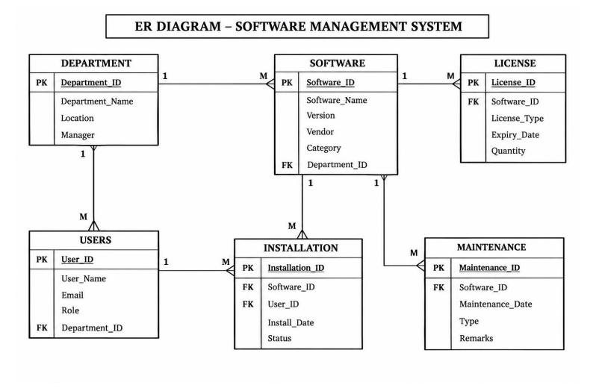
10
ER Diagram
Conceptual view of the database
SOFTWARE MANAGEMENT SYSTEM • DBMS
10

Slide 11
11
Team Responsibilities
Division of work for the project
M.SRUJANA
Introduction • Problem statement • Objectives • Scope • Documentation
1
S.BHAVYA TULASI
Entities • Attributes • Database structure
2
T.TEJA SRI
Relationships • Cardinality • Relational schema
3
SANJANA
ER diagram • Review preparation • Presentation support
4
SOFTWARE MANAGEMENT SYSTEM • DBMS
11

Slide 12
12
Conclusion
A structured database creates a clear foundation for software tracking.
ONE SYSTEM.
CLEAR DATA.
BETTER CONTROL.
The project identifies six major entities.
Primary Keys and Foreign Keys connect the data.
Relationships and cardinalities define how records interact.
The ER model and relational schema are ready for implementation.
DBMS • REVIEWF–I • 2026–2027
SOFTWARE MANAGEMENT SYSTEM • DBMS
12

